Slide 1
Section 10: Virtual Memory

Slide 2
Virtual Memory
Demand Paging
Copy-on-Write
Page Replacement
Allocation of Frames
Thrashing

Slide 3
Objectives
In the previous section, paging is used to allocate memory blocks (frames) to store processes non-contiguously in main memory
In this section we show how paging extend logical address space beyond the size of the physical address space
We introduce demand paging, page-fault handling, page replacement algorithms, frame allocation to processes, etc.

Slide 4
Virtual Memory
Virtual memory is a technique to execute processes which are not completely in memory
Only part of a process is in main memory during execution
The rest of the process stay on the hard disk
This memory is called “virtual” because the part of a process that is still on the hard disk is managed by the OS as if it was in main memory
Hard disk memory is huge, it is seen as part of main memory, so virtual memory is huge as well
This large memory is virtual however, if the part of a process on the hard disk is needed, it must be loaded into main memory

Slide 5
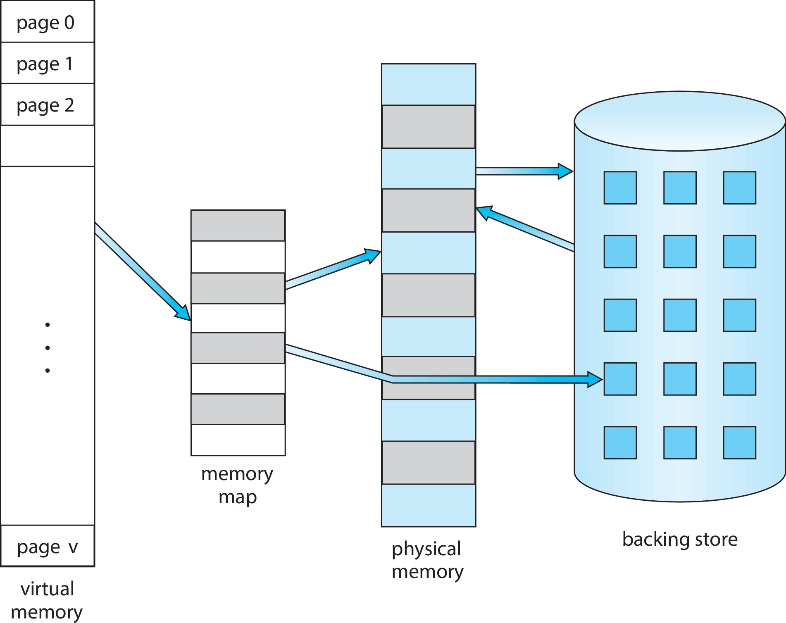
Some pages have no frame
The virtual address space could be larger than the physical (main)
memory, not all pages are allocated frames, the other are on hard disk
Entries of the page table for which no frame is allocated are empties

Slide 6
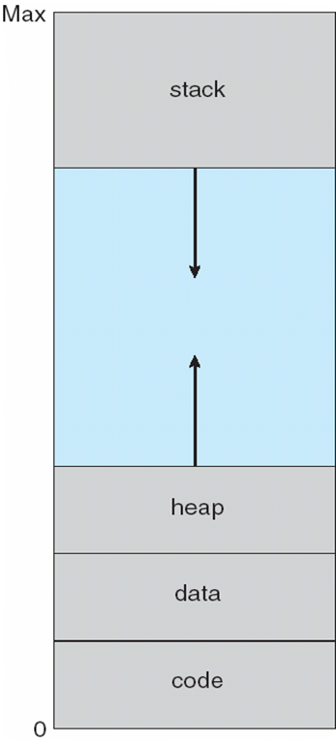
Example of virtual memory usefulness
Virtual address spaces include holes
Large empty space between the heap and stack
Holes can be filled during process execution
With virtual memory, wholes are not allocated any frame unless they are filled

Slide 7
Implementation: Demand Paging
Pages loaded when they are demanded during program execution
Pages which are not accessed don’t get loaded into physical memory
Initially, a process resides in secondary memory (hard disk)

Slide 8
Demand Paging
Need hardware support to distinguish between pages in memory and pages on the disk
The valid-invalid bit scheme (as described in the Memory Management Chapter) can be used for this purpose:
When this bit is set to valid, the associated page is both legal and in memory.
When invalid, the associated page either is not valid or is valid but is currently not on the disk

Slide 9
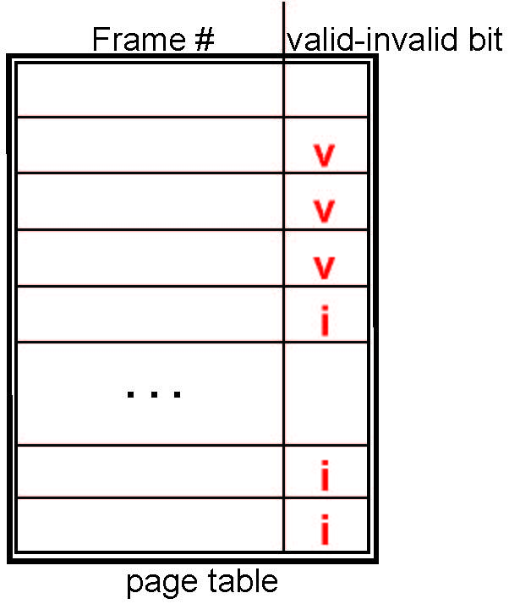
Valid-Invalid Bit
With each page table entry, a valid–invalid bit is associated (v ⇒ in-memory – memory resident, i ⇒ not-in-memory)
Initially valid–invalid bit is set to i on all entries
Example of a page table snapshot:
During MMU address translation, if valid–invalid bit in page table entry is i ⇒ page fault

Slide 10
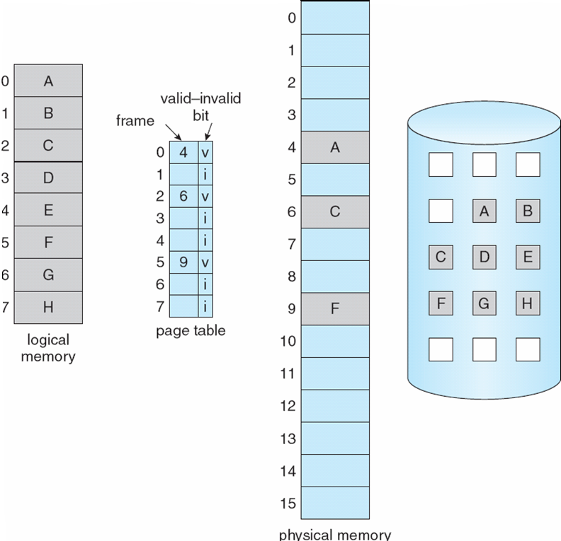
Page Table, some Pages not in Main Memory
After running for some time, pages have been loaded in memory, so page table has some valid-invalid bits set to v

Slide 11
Steps in Handling Page Fault
If there is a reference to a page, first reference to that page will be trapped by the operating system
Page fault
Operating system looks at another table to decide:
Invalid reference ⇒ abort
Just not in memory
Find free frame
Swap page into frame via scheduled disk operation
Reset tables to indicate page now in memory Set validation bit = v
Restart the instruction that caused the page fault

Slide 12

Steps in Handling a Page Fault
A reference is made to an entry in the page table that has the invalid bit set (therefore, no frame number in the corresponding table entry). Page fault
The interrupt handler determine whether the page fault is an invalid address, if so, terminate process
Otherwise, page is on disk (back store)
Find a free frame and swap in the frame the page from disk
Reset tables to indicate page now in memory Set validation bit = v
Restart the instruction that caused the page fault

Slide 13
Pure demand paging
Pure demand paging: A process is started with no pages loaded into main memory
Only the page table is in main memory initialized with invalid bits
First instruction causes a page fault

Slide 14
Stages in Demand Paging – Worse Case
Trap to the operating system
Save the process registers and process state in the PCB
Determine that the interrupt was a page fault
Check that the page reference was legal and determine the location of the page on the disk
Issue a read from the disk to a free frame:
Wait in a queue for this device until the read request is serviced
Wait for the device seek and/or latency time
Begin the transfer of the page to a free frame

Slide 15
Stages in Demand Paging (Cont.)
While waiting, allocate the CPU to some other user
Receive an interrupt from the disk I/O subsystem (I/O completed)
Save the registers and process state for the other user
Determine that the interrupt was from the disk
Correct the page table and other tables to show page is now in memory
Wait for the CPU to be allocated to this process again
Restore the user registers, process state, and new page table, and then
resume the interrupted instruction

Slide 16
Overhead of Demand Paging
Three major activities
Service the interrupt – careful coding means just several hundred instructions needed
Read the page – lots of time
Restart the process – again just a small amount of time
Page Fault Rate 0 ≤ p ≤ 1
if p = 0 no page faults
if p = 1, every reference is a fault
Effective Access Time (EAT)
EAT = (1 – p) x memory access
+ p (page fault overhead)

Slide 17
Overhead of demand paging: Example
Memory access time = 200 nanoseconds
Average page-fault service time = 8 milliseconds
EAT = (1 – p) x 200 + p (8 milliseconds)
= (1 – p) x 200 + p x 8,000,000
= 200 + p x 7,999,800
If one access out of 1,000 causes a page fault, then
p = .001
0.001 x 7,999,800 = 7999.8ns
EAT = 7999.8 + 200 = 8199.8ns
8199.8 / 200 = 40.999
This is a slowdown by a factor of more than 40!!

Slide 18
Overhead of demand paging: Example
Memory access time = 200 nanoseconds
Average page-fault service time = 8 milliseconds
If we want performance degradation < 10 percent, i.e. want EAT < 220ns:
220 > 200 + 7,999,800 x p 20 > 7,999,800 x p
p < .0000025
The probability p of a page fault should be smaller than 0.0000025, i.e. < one page fault in every 400,000 memory accesses

Slide 19
Process Creation: Copy-on-Write
Virtual memory allows benefits during process creation:
Copy-on-Write
fork() creates a copy of parent’s address space for the child
Duplicating the pages belonging to the parent.
Many child processes invoke the exec() system call immediately after creation.
The copying of the parent’s address space may be unnecessary.

Slide 20
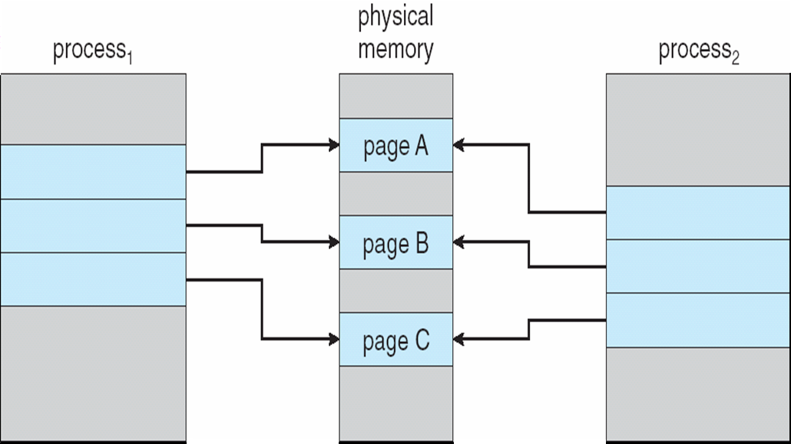
Copy-on-Write
The page table of the child process is a copy of the parent’s page table
Allows both parent and child processes to initially share the same frames in main memory

Slide 21
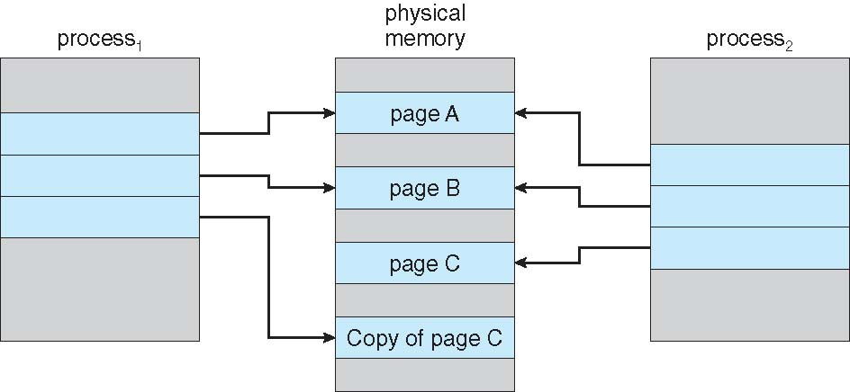
Copy-on-Write
If either process modifies a shared frame (marked as copy-on-write pages), the child page is copied in a new frame, and the child’s page table is updated
Faster process creation, only modified pages are copied
Minimize the number of allocated pages.
Copy-on-Write used by Windows, Linux, and macOS.

Slide 22
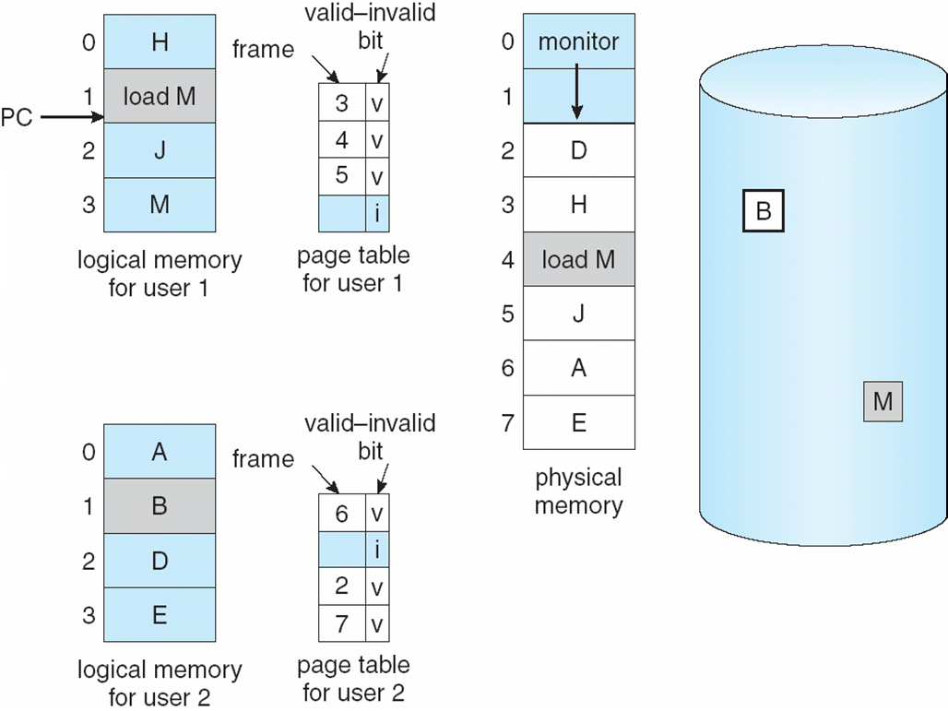
What happens if there is no free frame?
In order to load a page in main memory, there must be some free frames.

Slide 23
What happens if there is no free frame?
Need a page replacement strategy
Page replacement – find some page in memory, but not really in use, swap it out
Issues:
algorithm
performance – want an algorithm which will result in minimum number of page faults

Slide 24
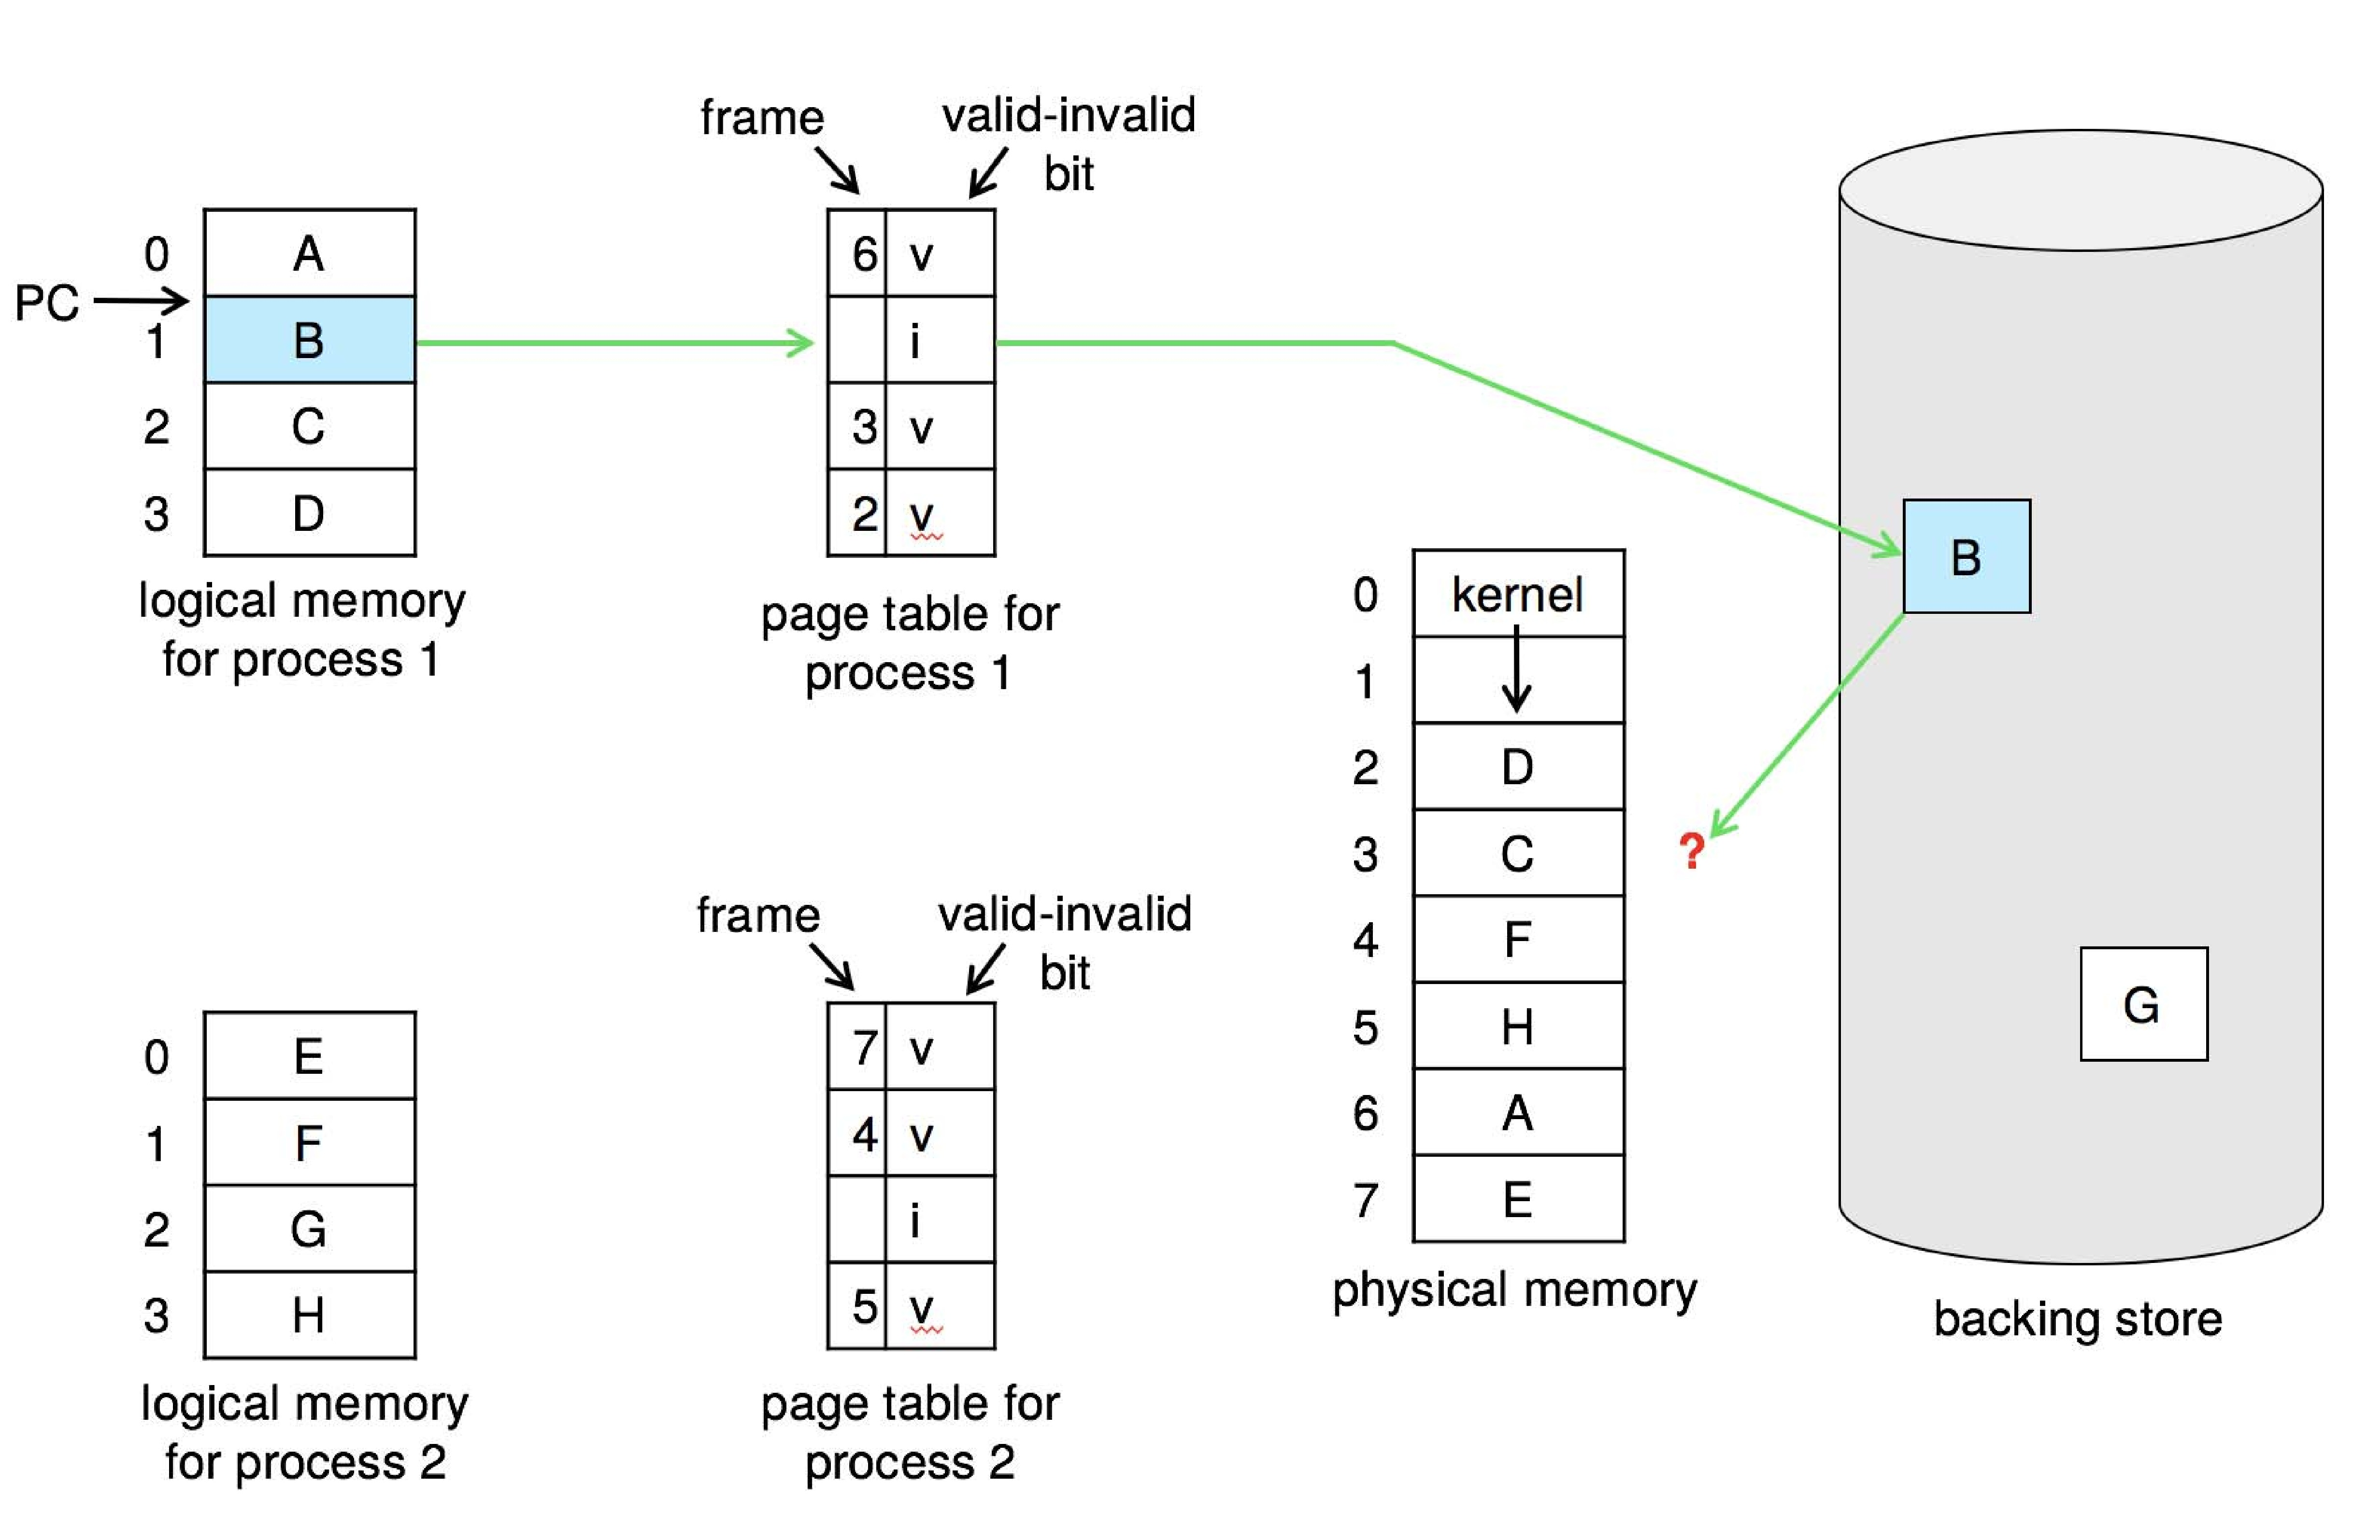
Need For Page Replacement

Slide 25
Basic Page Replacement
Find the location of the desired page on disk
Find a free frame: - If there is a free frame, use it - If there is no free frame, use a page replacement algorithm to select a victim frame
Bring the desired page into the (newly) free frame; update the page and frame tables
Restart the process

Slide 26
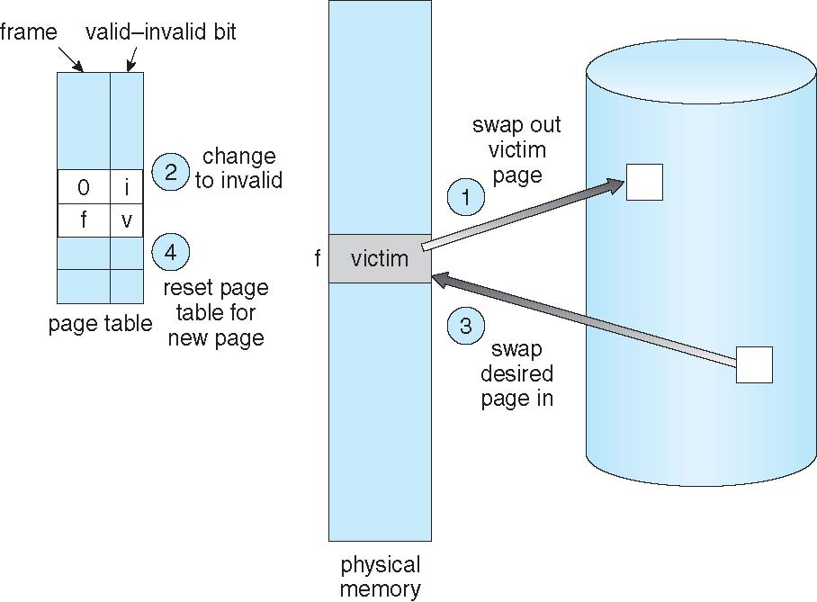
Page Replacement
Find the location of the desired page on disk
If there is no free frame, use a page replacement algorithm to select a victim frame
Bring the desired page into the (newly) free frame; update the page and frame tables
Restart the process

Slide 27
Page Replacement
Two-page transfer (one out and one in) needed
Double the page-fault service time!
We can reduce the overhead by using a modify bit (dirty bit)
The modify bit for a page is set whenever any word or byte in the page is written into, since it was read in from the disk
When we select a page for replacement, we examine its modify bit.
If set, we must write that page to the disk.
If not set, we need not write the page to the disk.
Page replacement completes separation between logical memory and physical memory – large virtual memory can be provided on a smaller physical memory

Slide 28
Page and Frame Replacement Algorithms
Frame-allocation algorithm determines
How many frames to give each process
Which frames to replace
Page-replacement algorithm
Want lowest page-fault rate on both first access and re-access
Evaluate page replacement algorithm by running it on a particular string of memory references (reference string) and computing the number of page faults on that string
String is just page numbers, not full addresses
Repeated access to the same page does not cause a page fault
Results depend on number of frames available
In all our examples, the reference string of referenced page numbers is
7,0,1,2,0,3,0,4,2,3,0,3,0,3,2,1,2,0,1,7,0,1

Slide 29
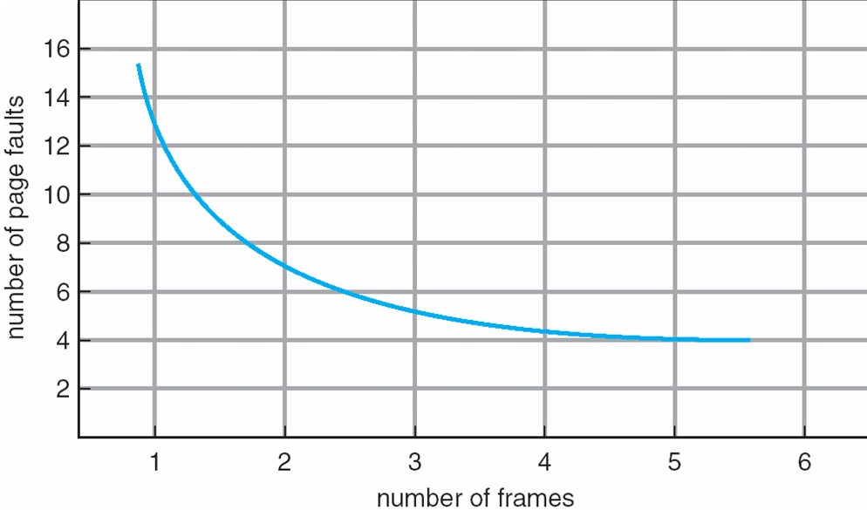
Graph of Page Faults Versus the Number of Frames
To calculate the number of page faults, we need to know the number of frames available
Ideally, we expect as the number of frames available increases, the number of page faults decreases

Slide 30
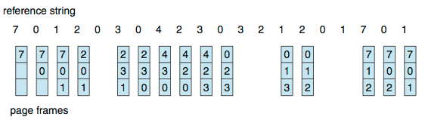
First-In-First-Out (FIFO) Algorithm
FIFO replacement algorithm: Select the oldest page for replacement
Reference string: 7,0,1,2,0,3,0,4,2,3,0,3,0,3,2,1,2,0,1,7,0,1
3 frames (3 pages can be in memory at a time per process)
How to track ages of pages?
Just use a FIFO queue
15 page faults

Slide 31
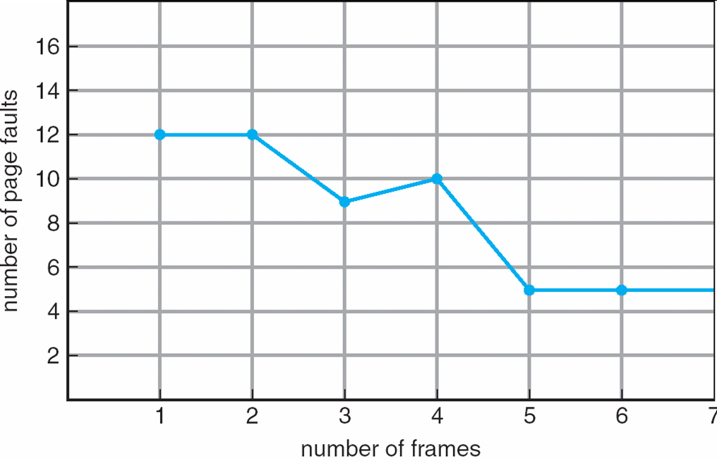
FIFO & Belady’s Anomaly
Page-fault rate may increase as the number of allocated frames increases

Slide 32
Example Belady’s Anomaly for FIFO
Reference string: 1, 2, 3, 4, 1, 2, 5, 1, 2, 3, 4, 5
3 frames (3 pages can be in memory at a time per process)
4 frames
Belady’s Anomaly: more frames ⇒ more page faults
1
1
4
5
2
2
1
3
9 page faults
3
3
2
4
1
1
5
4
2
2
1
5
10 page faults
3
3
2
4
4
3
Notes:
32

Slide 33
Optimal Algorithm
Replace page that will not be used for longest period of time
4 frames example
1, 2, 3, 4, 1, 2, 5, 1, 2, 3, 4, 5
1
4
2
6 page faults
3
4
5
Notes:
33

Slide 34
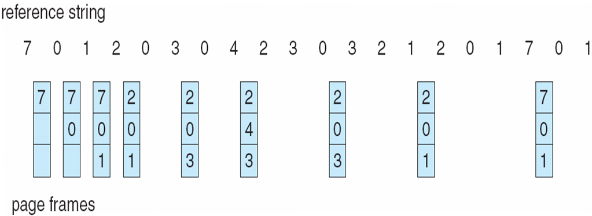
Optimal Page Replacement
For the above example, 9 page faults is optimal
But optimal page-replacement algorithm is impossible to implement. Requires future knowledge of the reference string.
Algorithm used mainly for comparison studies.

Slide 35
Least Recently Used (LRU) Algorithm
Replace the page that has not been used for the longest period of time
LRU seen as an approximation of OPT Algo
Reference string: 1, 2, 3, 4, 1, 2, 5, 1, 2, 3, 4, 5
1
1
1
1
5
2
2
2
2
2
3
5
5
4
4
4
4
3
3
3
Notes:
35

Slide 36
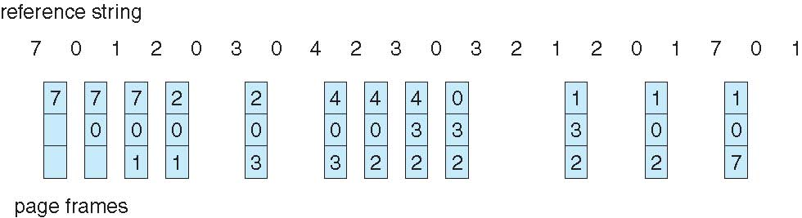
Least Recently Used (LRU) Algorithm
Use past knowledge rather than future
Replace page that has not been used in the most amount of time
Associate time of last use with each page
12 faults – better than FIFO but worse than OPT
Generally good algorithm and frequently used
But how to implement?

Slide 37
LRU Algorithm (Cont.)
Counter implementation
Every page entry has a counter; every time page is referenced through this entry, copy the clock into the counter
When a page needs to be changed, look at the counters to find smallest value
Search through table needed
Stack implementation
Keep a stack of page numbers in a double link form:
Page referenced:
move it to the top
requires 6 pointers to be changed
Each update more expensive
No search for replacement

Slide 38
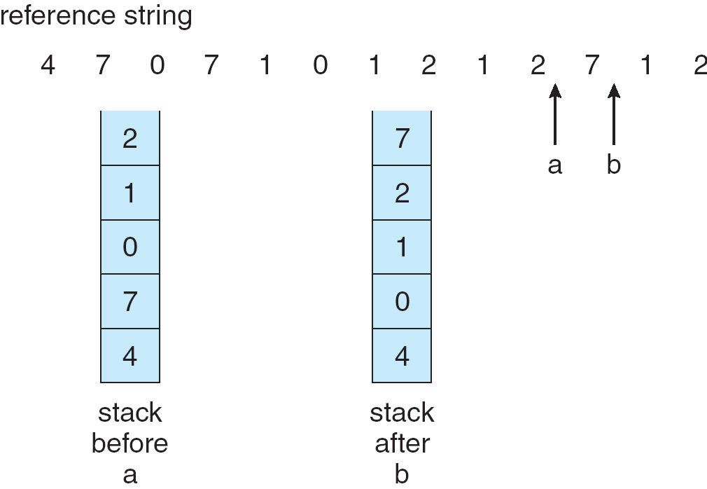
LRU: Stack Implementation
Keep a stack of page numbers in a doubly link list:
Page referenced:
move it to the top
requires 6 pointers to be changed
No search for replacement
LRU and OPT are cases of stack algorithms that don’t have Belady’s Anomaly
Notes:
38

Slide 39
Allocation of Frames
Must decide how many frames to allocate for each process
Each process needs minimum number of pages
To reduce page-fault rate
To resolve a single instruction
number of frames that a single instruction can reference
this minimum defined by the computer architecture
For example – a system in which all memory-reference instructions have only one memory address.
We need one frame for the instruction and one frame for the memory reference.
Two major allocation schemes
fixed allocation
priority allocation
Notes:
39

Slide 40
Fixed Allocation
Equal allocation – For example, if there are 100 frames (after allocating frames for the OS) and 5 processes, give each process 20 frames
Proportional allocation – Allocate according to the size of process
Dynamic as degree of multiprogramming, process sizes change

Slide 41
Global vs. Local Allocation
Frame can be allocated through page replacement
Page replacement algorithms can be classified in two categories:
Local replacement
Global replacement
Global replacement – process selects a replacement frame from the set of all frames; one process can take a frame from another
For a high priority process, replacement can select a victim from a low priority process
Number of frames allocated to a process change, so process execution time can vary greatly
But greater throughput so more common
Local replacement – each process selects from only its own set of allocated frames
More consistent per-process performance
But possibly underutilized memory

Slide 42
Thrashing
Thrashing ≡ a process that does not have enough frames, when it page-fault, it replaces page that it needs right away.
When trashing, processes are busy swapping pages in and out, spending more time paging than executing
If a process does not have “enough” frames, the page-fault rate is very high. This leads to:
low CPU utilization
OS thinks that it needs to increase the degree of multiprogramming
another process added to the system, stealing frames from the process that is trashing
resulting in even more trashing and even lower CPU utilization
Notes:
42

Slide 43
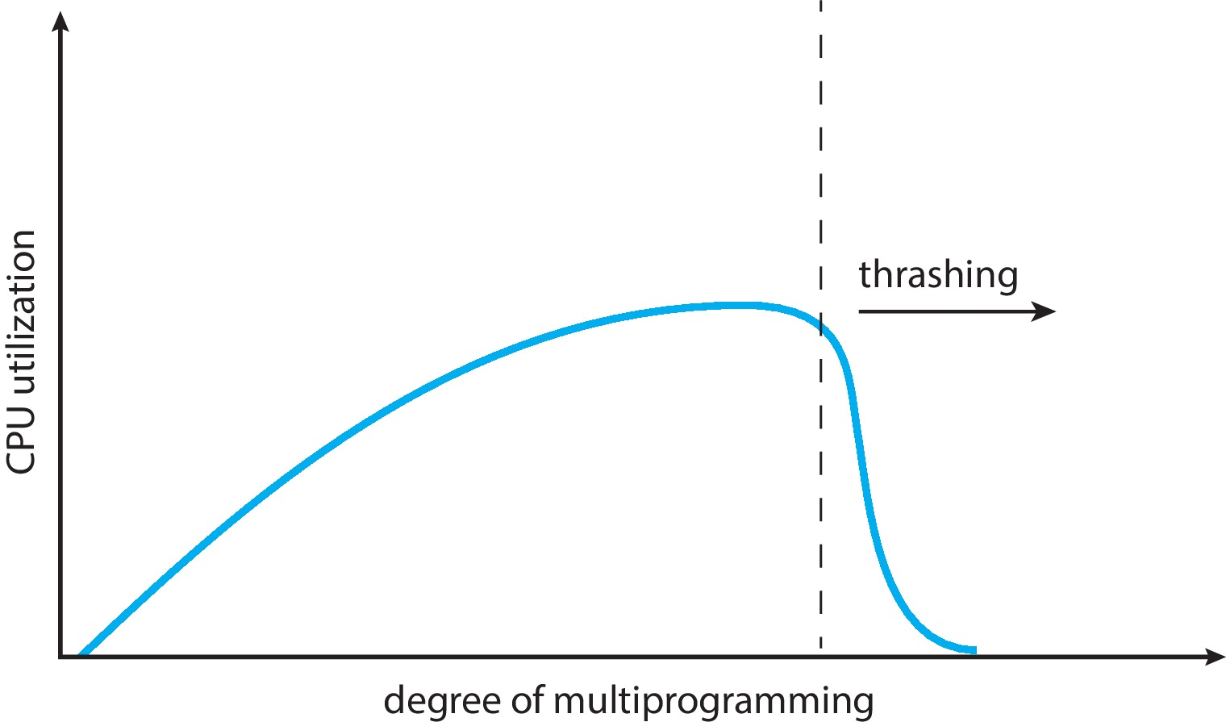
Thrashing (Cont.)
Thrashing. A process is busy swapping pages in and out

Slide 44
Thrashing
We can limit the effects of thrashing using local replacement
If one process starts thrashing, cannot steal frames from another process
However, the queue of the paging device will contain a lot of requests
The service time for a page fault of a non-thrashing process will also increase
To prevent thrashing, must provide a process with as many frames as it needs.
We don’t know how many frames a process needs
Process’s memory references generally exhibit locality of patterns, or locality model of execution
Locality: a set of pages actively used together
For example, the locality of a function call consists of the memory references of the function instructions, its local variables, and a subset of the global variables.
The locality model states that, as a process executes, it moves from locality to locality

Slide 45
Locality In A Memory-Reference Pattern

Slide 46
Working-Set Strategy
Why does thrashing occur?
We allocate fewer frames than the size of the current locality process
Based on the locality model, the working-set strategy tries to identify how many frames a process is actually using
The method uses a parameter, ∆, to define the working-set window
The idea is to examine the most recent page references.
The set of page in the most recent ∆ page references is the working set
Notes:
46

Slide 47
Working-Set Model
Δ ≡ working-set window ≡ a fixed number of page references Example: 10,000 instructions
WSS_{i} (working set of Process P_{i}) = total number of pages referenced in the most recent Δ (varies in time)
if Δ too small will not encompass entire locality
if Δ too large will encompass several localities
if Δ = ∞ ⇒ will encompass entire program
D = Σ WSS_{i} ≡ total demand frames
Approximation of locality

Slide 48
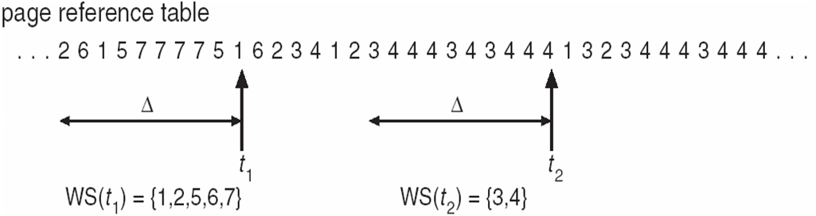
Working-Set Model (Cont.)
if D > m ⇒ Thrashing (where m is the total number of frames)
Policy if D > m, then suspend or swap out one of the processes

Slide 49
Keeping Track of the Working Set
Approximate with interval timer + a reference bit
Example: Δ = 10,000
Timer interrupts after every 5000 time units
Keep in memory 2 bits for each page
Whenever a timer interrupts copy and sets the values of all reference bits to 0
If one of the bits in memory = 1 ⇒ page in working set
Why is this not completely accurate?
Improvement = 10 bits and interrupt every 1000 time units

Slide 50
Page-Fault Frequency
More direct approach than WSS
Establish “acceptable” page-fault frequency (PFF) rate and use local replacement policy
If actual rate too low, process loses frame
If actual rate too high, process gains frame

Slide 51
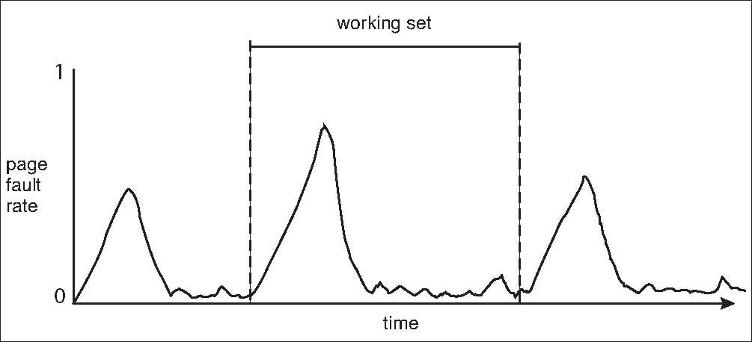
Working Sets and Page Fault Rates
Direct relationship between working set of a process and its page-fault rate
Working set changes over time
Peaks and valleys over time

Slide 52
Operating System Examples
Windows

Slide 53
Windows
Uses demand paging with clustering. Clustering brings in pages surrounding the faulting page
Processes are assigned working set minimum and working set maximum
Working set minimum is the minimum number of pages the process is guaranteed to have in memory
A process may be assigned as many pages up to its working set maximum
When the amount of free memory in the system falls below a threshold, automatic working set trimming is performed to restore the amount of free memory
Working set trimming removes pages from processes that have pages in excess of their working set minimum

Slide 54
End of Section 10

